Slide 1
A procrastination preview

Slide 2
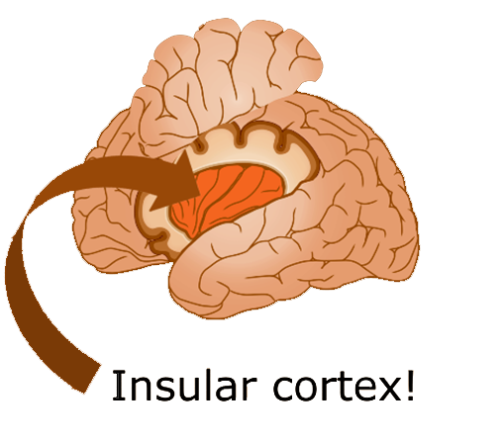

Slide 3
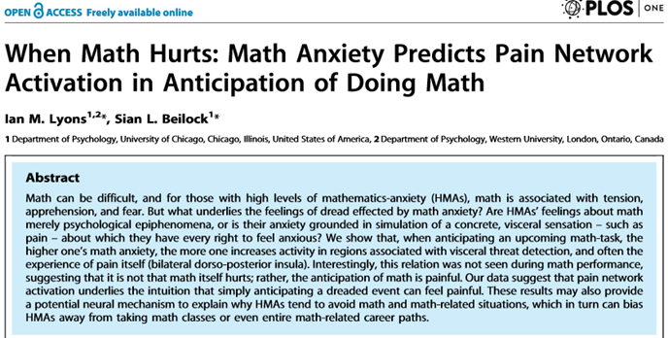

Slide 4
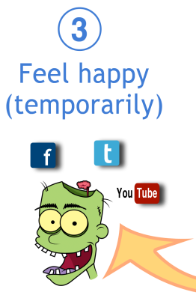
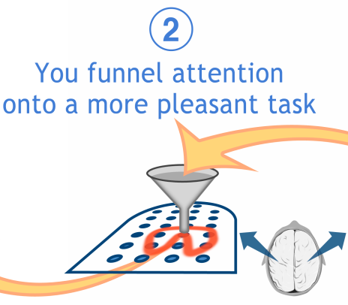

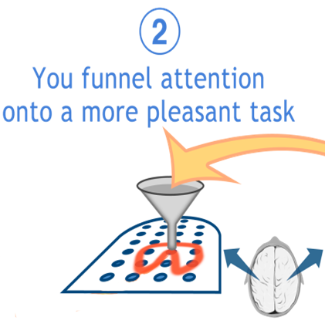
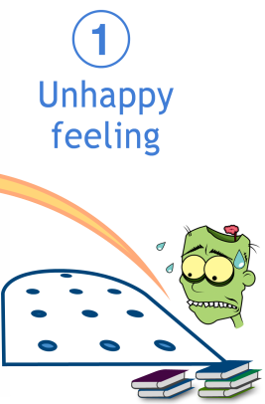


Slide 5
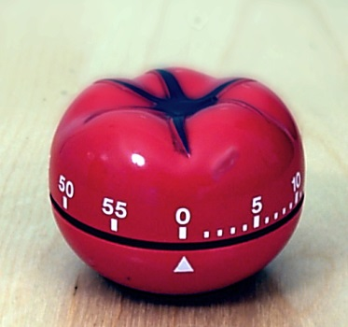
Pomodoro
25 minutes
no interruptions
focus
reward!

Slide 6
Illustration Credits
Insular cortex, image © 2014 Kevin Mendez
Procrastination funneling, image © 2014 Kevin Mendez
Pomodoro timer, Autore: Francesco Cirillo rilasciata a Erato nelle sottostanti licenze seguirÃ OTRS, http://en.wikipedia.org/wiki/File:Il_pomodoro.jpg
“Barbara Oakley at age 10 (September 1966) with Earl the lamb.” Photo courtesy Barbara Oakley
Recommended reading
Boice, Robert. Procrastination and Blocking. Westport, CT: Praeger, 1996.
Lyons, I.M., and S.L. Beilock. "When Math Hurts: Math Anxiety Predicts Pain Network Activation in Anticipation of Doing Math." PLoS ONE 7, no. 10 (2012): e48076.
Steel, Piers. The Procrastination Equation. NY: Random House, 2010.
Steel, Piers. "The Nature of Procrastination: A Meta-Analytic and Theoretical Review of Quintessential Self-Regulatory Failure." Psychological Bulletin 133, no. 1 (Jan 2007): 65-94.
Tuckman, Bruce W., and Henri C. Schouwenburg. "Behavioral Interventions for Reducing Procrastination among University Students." In Counseling the Procrastinator in Academic Settings, edited by H.C. Schouwenburg, CH Lay, TA Pychyl and JR Ferrari Washington, DC: American Psychological Association, 2004.

